Slide 1
Information Processing and Retrieval
GOODREADS’ BOOKS AND REVIEWS
Diogo Almeida (up201806630)
Pedro Queirós (up201806329)

Slide 2
Milestone 1 Overview
The data used for this information system was extracted from Kaggle and Goodreads’ website regarding books and their reviews. After the data preparation has been completed, the information is split across several csv files:
Awards
Characters
Genre and votes
Books
Reviews

Slide 3
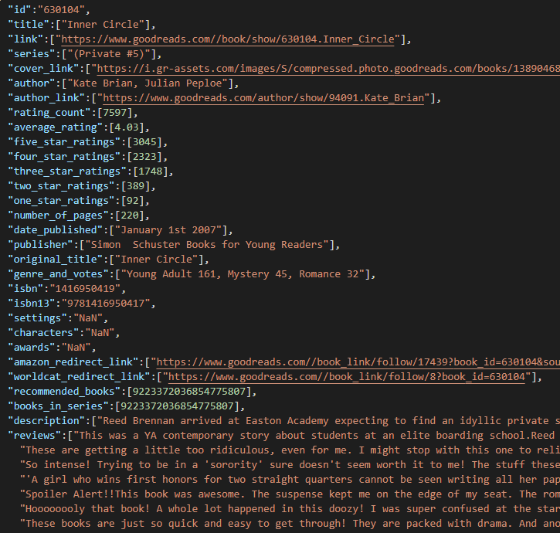
Collections and Documents
Firstly, the files regarding books, gender and votes, characters and awards were merged with the books file, each one added as an attribute of the book.
Then, the reviews were also merged in order to have for each book an array of its reviews.
The final data is gathered in a JSON file and uploaded to a previously created collection (core) in Solr

Slide 4
Indexing Process
The custom type standard_text was created with the following filters:
ASCIIFoldingFilterFactory
LowerCaseFilterFactory
SynonymFilterFactory
Field | Type | Index
isbn, isbn13 | string | No
title, series, author, date_published, publisher, original_title, genre_and_votes, settings, characters, awards, recommended_books, books_in_series, descprition, reviews | standard_text | Yes

Slide 5
Indexing Process
Field | Type | Index
rating_count, five_star_ratings, four_star_ratings, three_star_ratings, two_star_ratings, one_star_ratings | pint | No
average_rating | pfloat | No
link, cover_link, author_link,amazon_redirect_link, worldcat_redirect_link | string | No
isbn, isbn13 | string | No
title, series, author, date_published, publisher, original_title, genre_and_votes, settings, characters, awards, recommended_books, books_in_series, descprition, reviews | standard_text | Yes

Slide 6
Configurations
Three system configurations were created in order to explore and obtain different results while querying the documents in the SOLR:
Schemaless
With the schema presented in the previous slide
With the schema presented in the previous slide with weighting filter to boost more relevant fields

Slide 7
Information Need 1
Information Need: Biographies about Adolf Hitler
Relevance Judgement: “Biography” needs to be in the book’s genre, title or description. “Hitler” is also important to appear in the book’s title or author and can also appear in the description, although with less relevance.
Query(q): hitler AND biography
Query fields(qf): title genre_and_votes description author
Boost Query(bq): title^3 genre_and_votes^2 description^1 author^3

Slide 8
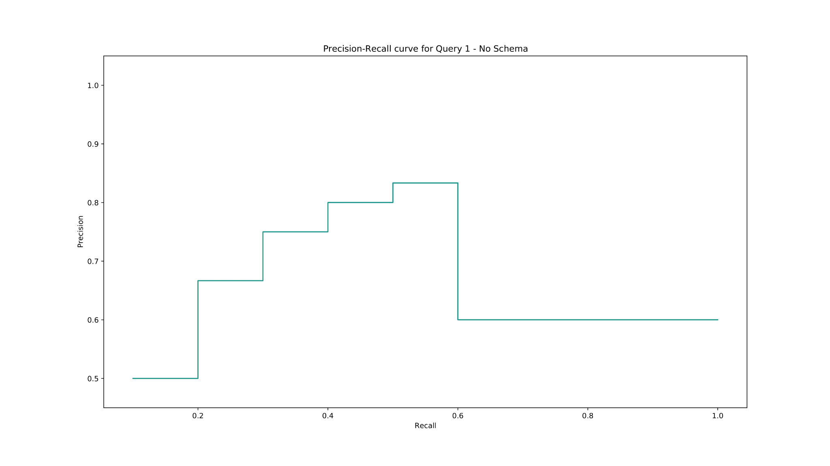
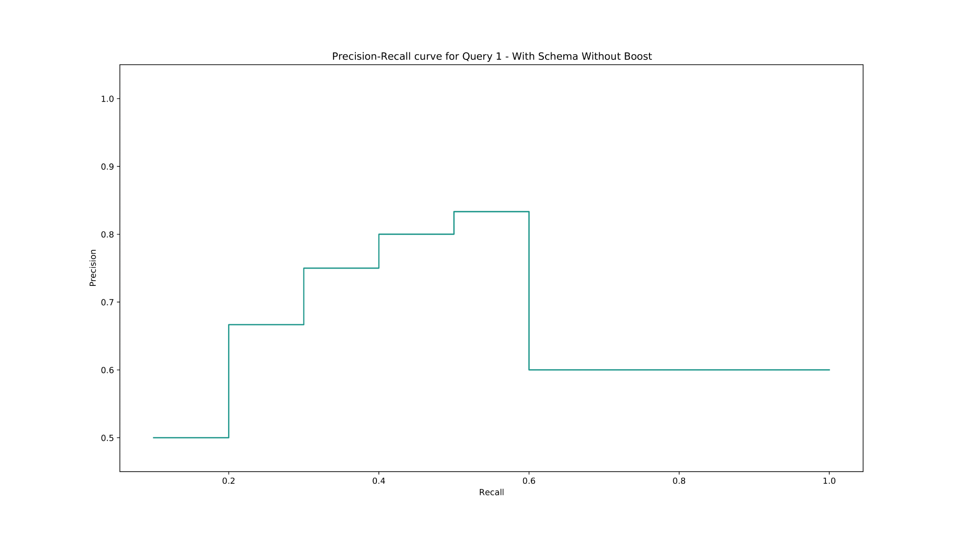
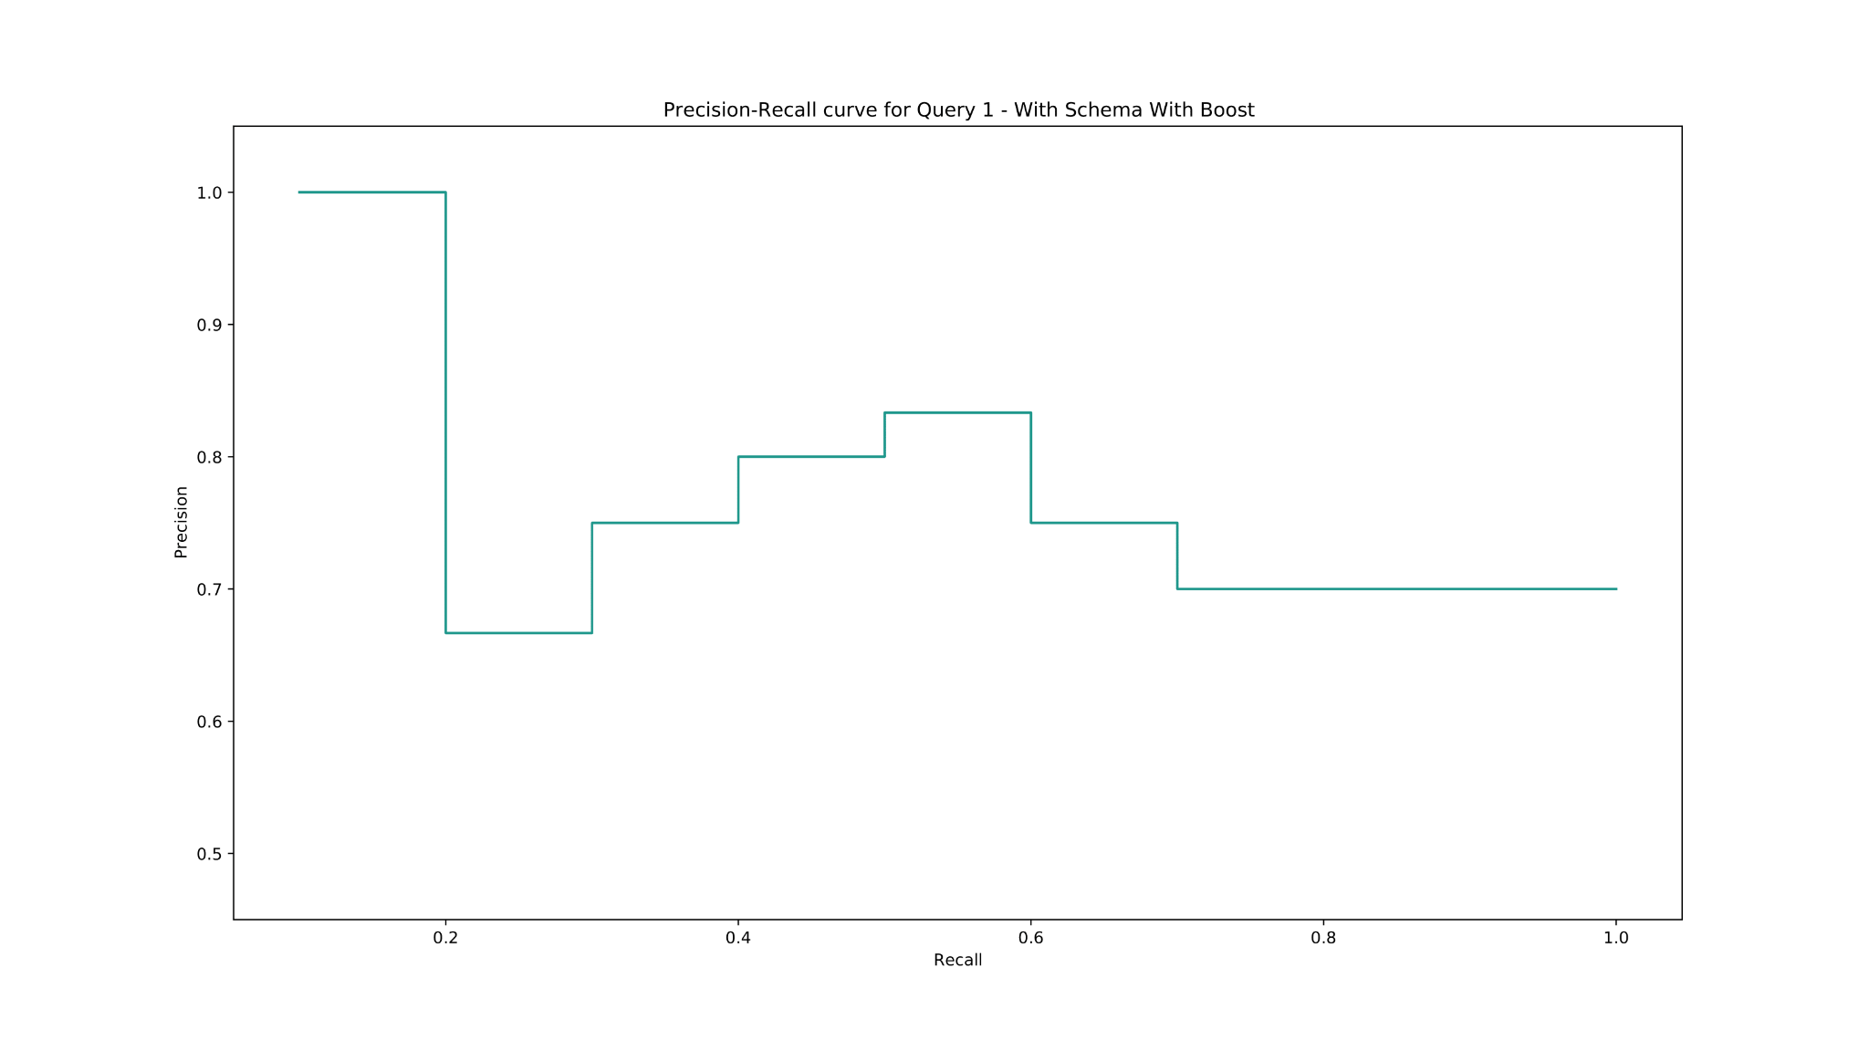
Information Need 1 - Evaluation
Rank | System 1 | System 2 | System 3
AVP | 0.781429 | 0.781429 | 0.836376
P@10 | 0.6 | 0.6 | 0.7

Slide 9
Information Need 2
Information Need: Comic books whose protagonist is Spider-Man
Relevance Judgement: The super hero name should most importantly appear in the book’s title but can also appear with less relevance in the description or characters. We are also looking for comic books so this should the the book’s genre.
Query(q): comics AND ("spider-man" OR "Peter Parker")
Query fields(qf): title genre_and_votes description characters
Boost Query(bq): title^3 genre_and_votes^2 description^1 characters^2

Slide 10
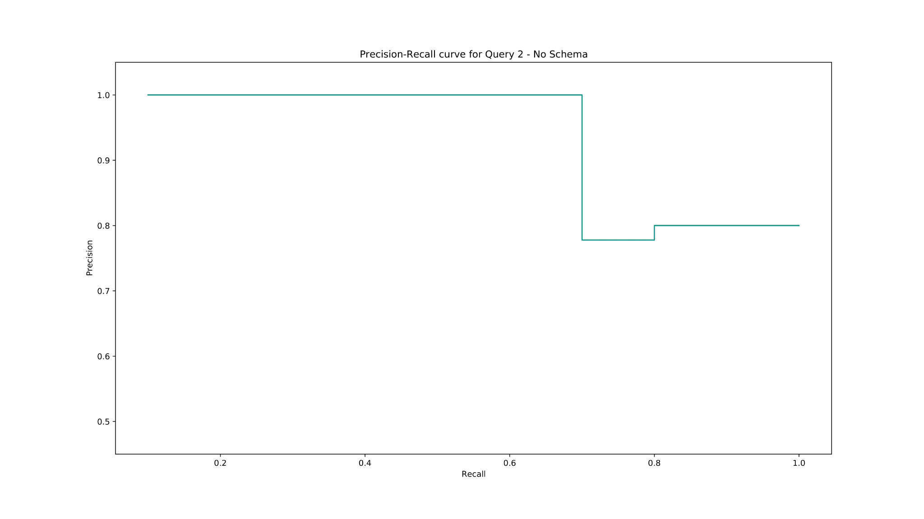
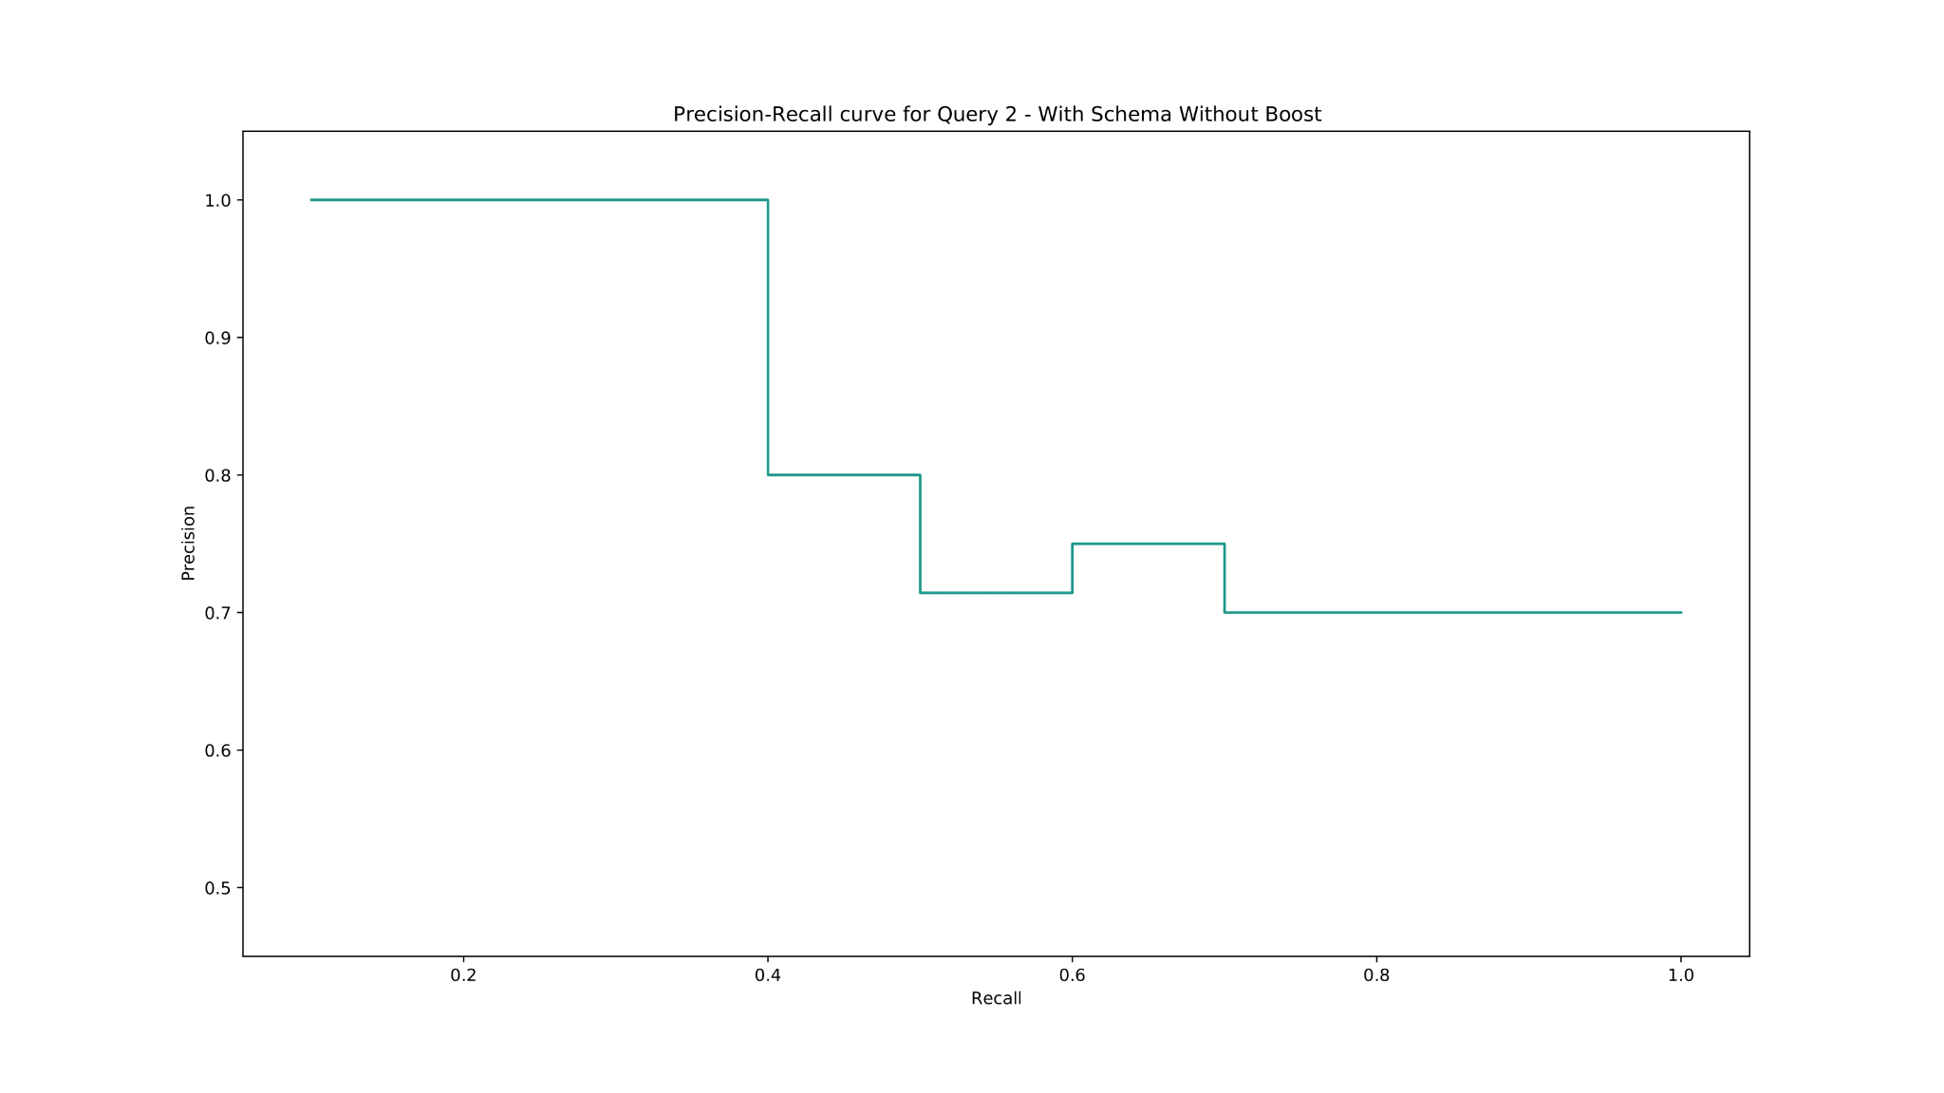
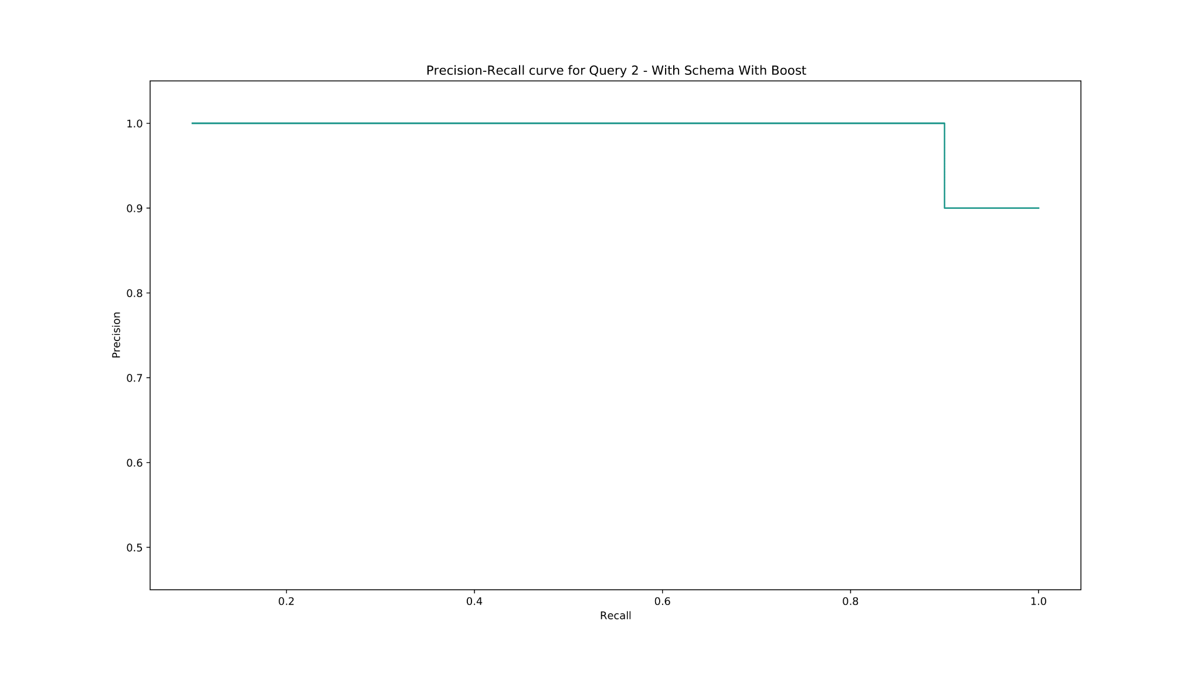
Information Need 2 - Evaluation
Rank | System 1 | System 2 | System 3
AVP | 0.971429 | 0.893519 | 1
P@10 | 0.8 | 0.7 | 0.9

Slide 11
Information Need 3
Information Need: Non-fictional books about the life’s work of Albert Einstein
Relevance Judgement: The scientist must be either the book’s author or have his name in the title. He can also be part of the book’s characters. His name can also appear in the description although it is less relevant. Science or Philosophy must be in the book’s genre and can also appear in the description or the title.
Query(q): einstein AND -fiction AND (philosophy OR science)
Query fields(qf): title genre_and_votes description characters
Boost Query(bq): title^3 genre_and_votes^2 description^1 characters^3

Slide 12
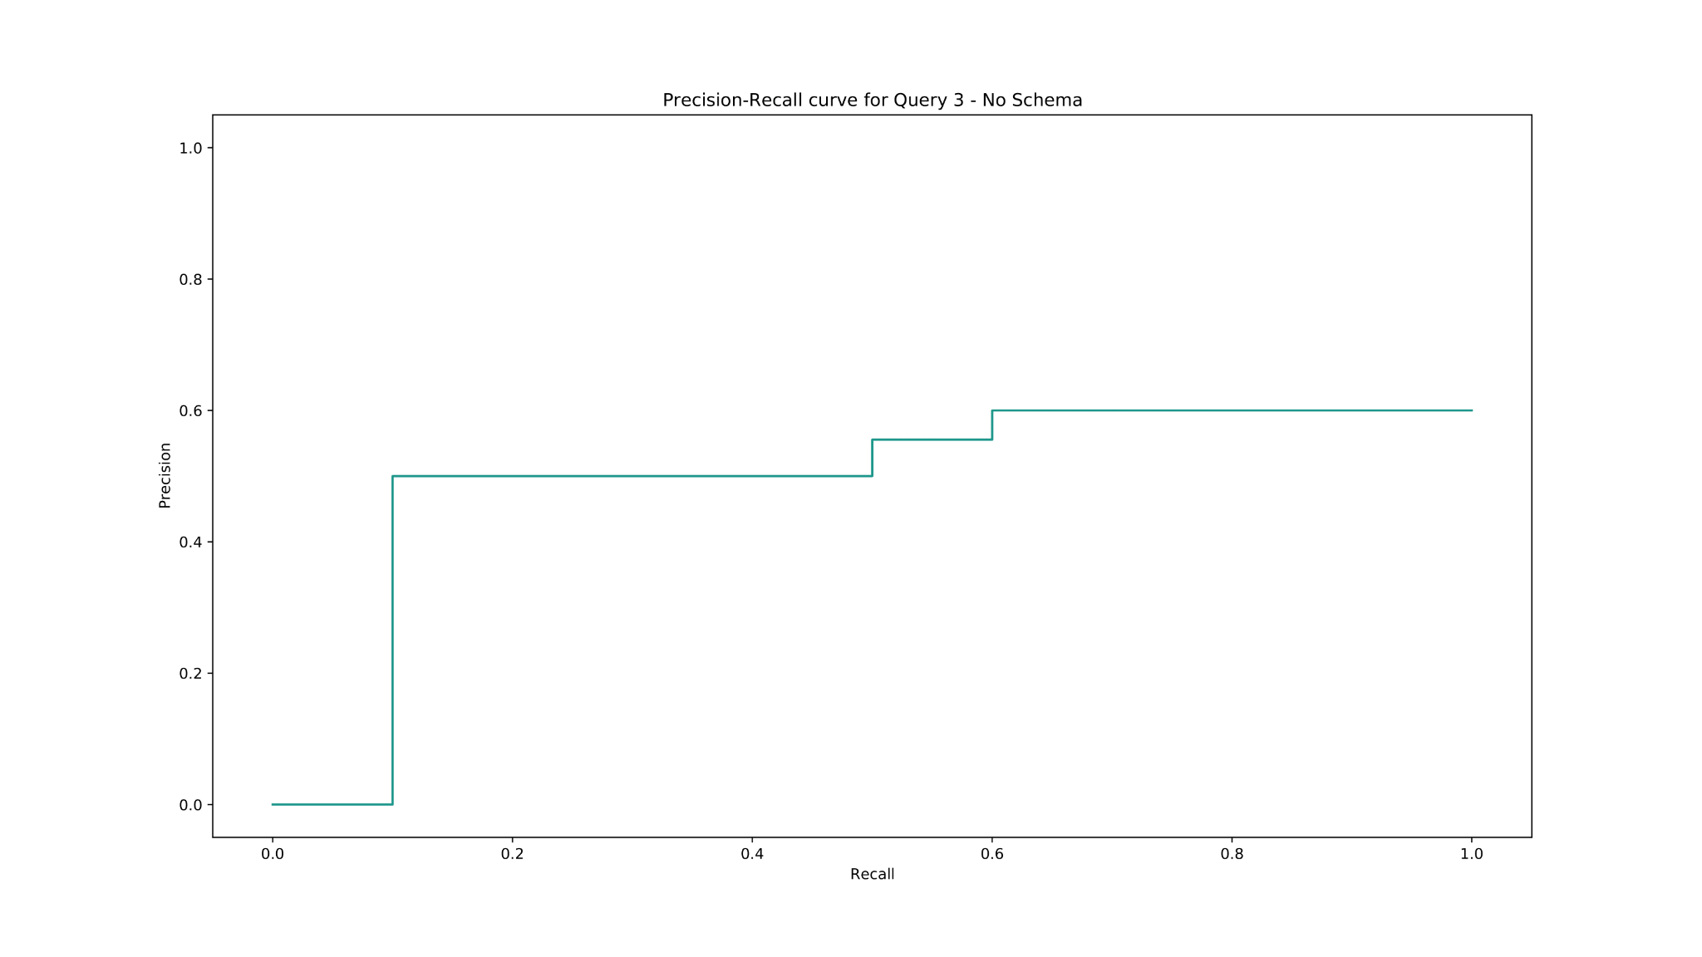
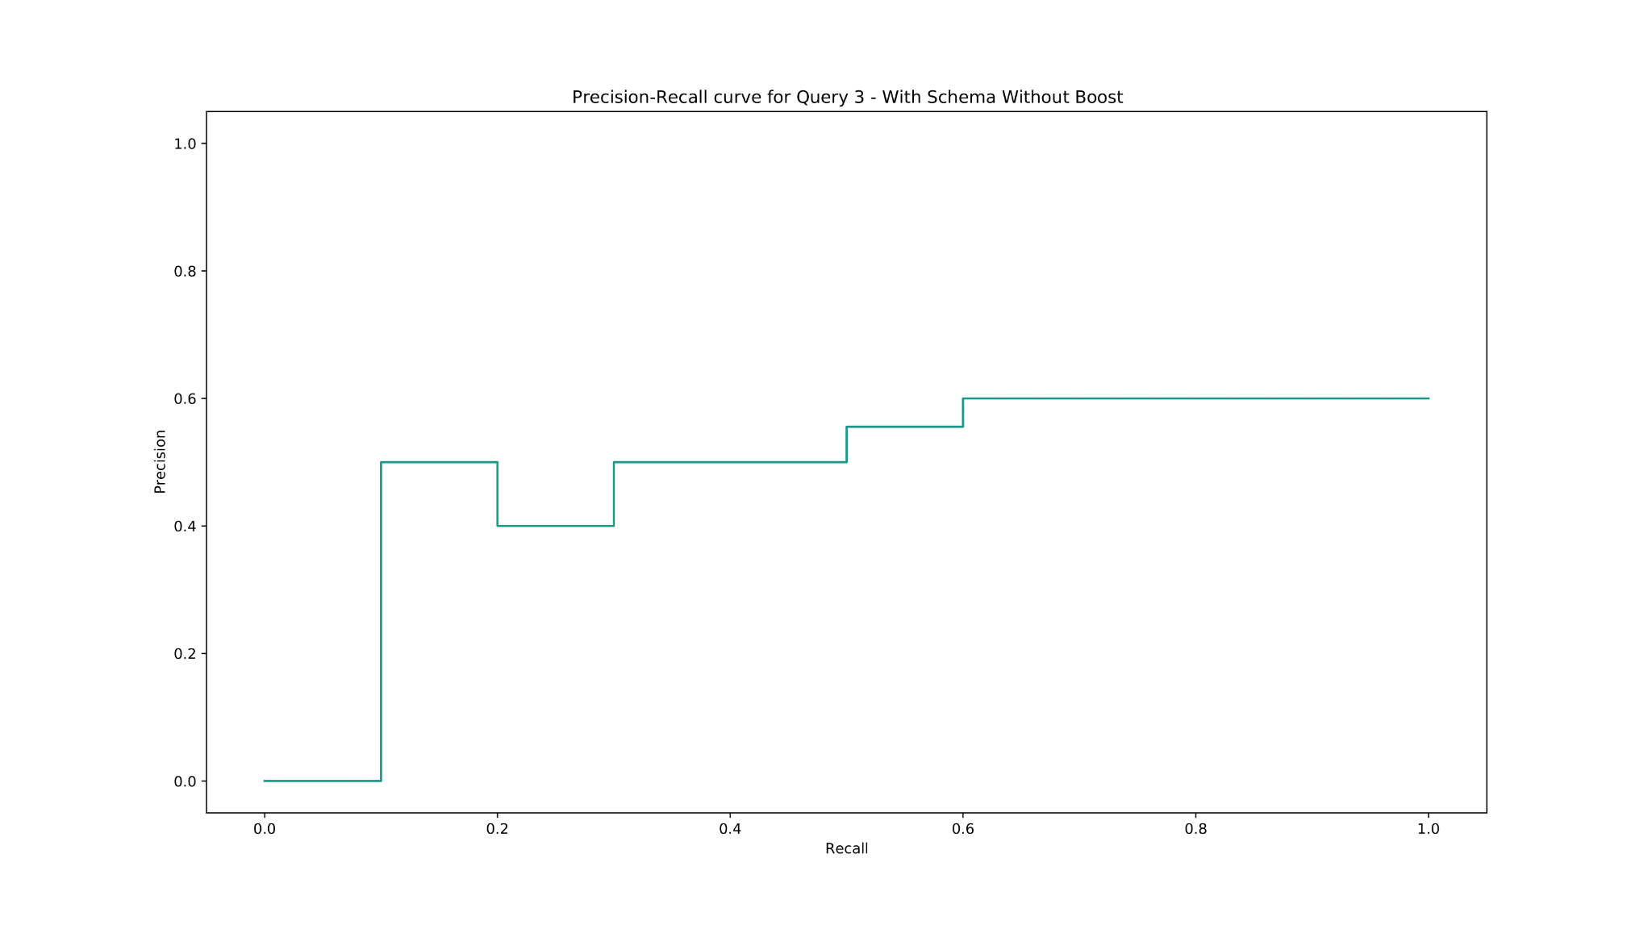
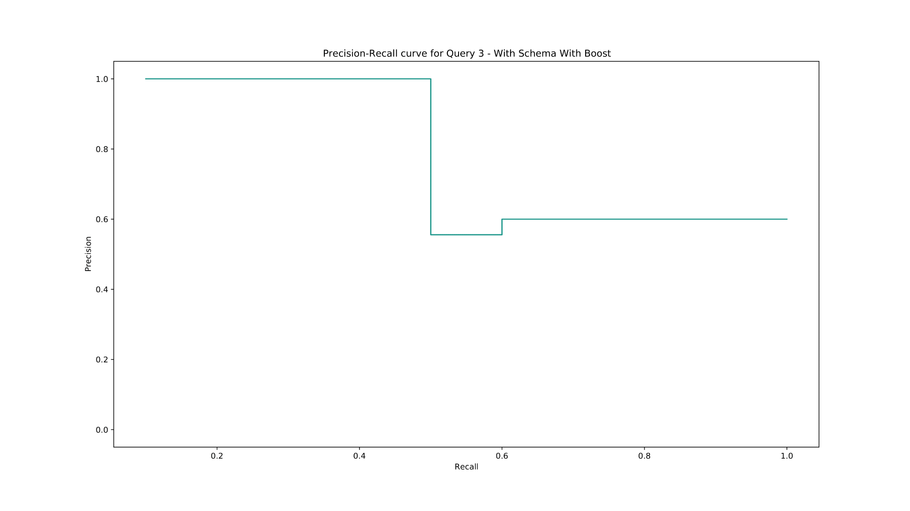
Information Need 3 - Evaluation
Rank | System 1 | System 2 | System 3
AVP | 0.582275 | 0.565608 | 0.92
P@10 | 0.6 | 0.6 | 0.6

Slide 13
Information Need 4
Information Need: Fantasy children’s books set in the medieval era that are easy to read
Relevance Judgement: We are looking for books that are easy to read, something that is not in the books’ informations. So it is important to search in the reviews of each book. The genres of the books must include fantasy and children’s and the story should be set in a medieval era (should mention “kingdom”)
Query(q): hitler AND biography
Filter Query(fq): genre_and_votes:fantasy
Filter Query(fq): genre_and_votes:childrens
Filter Query(fq): description:kingdom
Query fields(qf): reviews
Phrase fields(pf): reviews^5
Phrase slop(ps): 5
Boost Query(bq): reviews^2

Slide 14
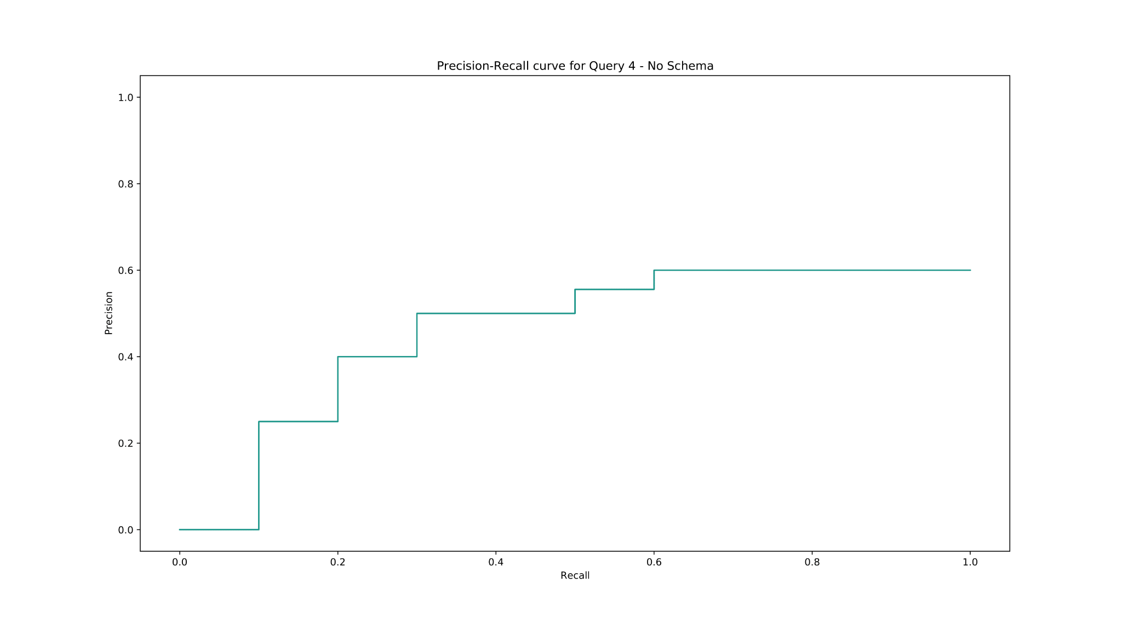
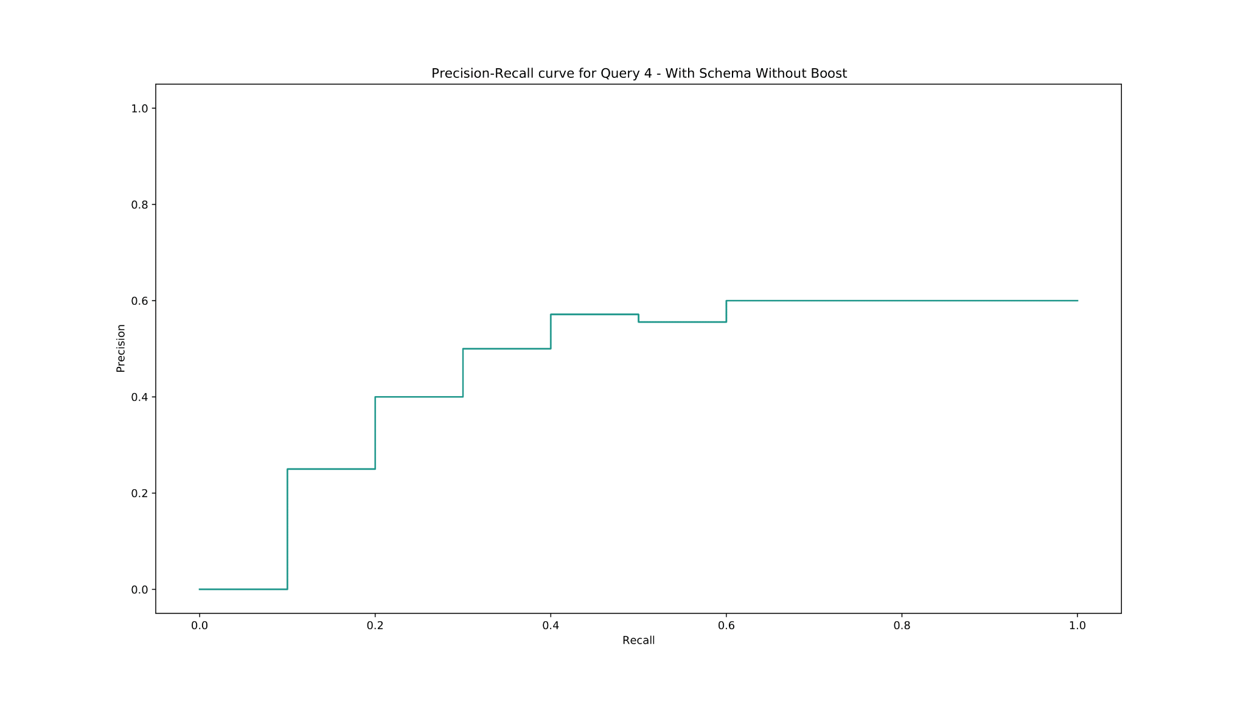
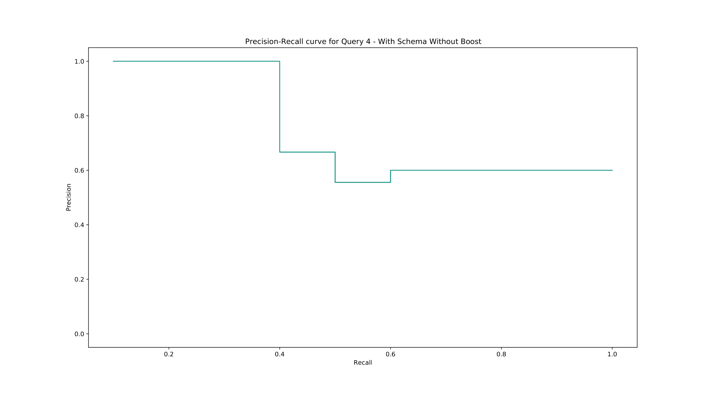
Information Need 4 - Evaluation
Rank | System 1 | System 2 | System 3
AVP | 0.493386 | 0.50496 | 0.862857
P@10 | 0.6 | 0.6 | 0.6

Slide 15
Conclusions and Future Work
For the information processing and retrieval we took the following steps:
Merged all the csv files into one JSON file;
Uploaded the data to the chosen tool - SOLR;
Queried and evaluated the results for each system.
Regarding future work, some of the implemented search tasks will be:
Improve query results by using NLP to better recognize user needs;
Development of a graphic interface for the information system.

